Slide 1

Session 7
Linked Lists

Slide 2
Session Objectives
Explain link list
Explain representation of linked lists in memory
Explain linked list declaration
Travers a linked list
Search a linked list
Insert nodes into a link list
Delete nodes into a link list
Explain a doubly linked list
Explain circular linked lists

Slide 3
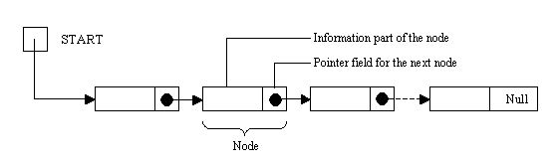
Linked Lists
A linked list is a linear collection of data elements, called nodes,
where the linear order is given by means of pointers.
Each node is divided into two parts
  information of the element
  link field, contains the address of the next node in the list
A linked list also contains a list pointer variable, which contains
the address of the first node in the list.

Slide 4
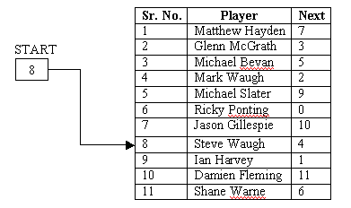
An example of Linked List
The above figure represents a linked list in the memory where each
node of the list contains a single character.

Slide 5
Linked List Declaration
A linked list storing information of players of a cricket team can be
declared as :
struct player
Note that next is declared
as a pointer to the structure
player itself.
{
char name[30];
struct player *next;
Remember, that the last
node in the list should have
its pointer, next, set to the
value NULL.
};

Slide 6
Traversing A Linked List (1)
A declared linked list can be traversed and each node can be
processed
If the previous example is considered, and a pointer variable, ptr
of the above struct type is declared
Set ptr to start
While !ptr = NULL do steps 3 & 4
Process the name(info part) of the node to which ptr is
currently pointing.
Set ptr to next part of the node to which ptr is pointing to
currently.
Exit

Slide 7
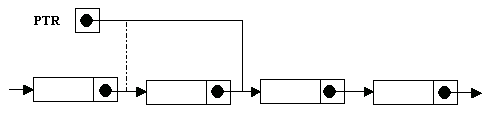
Traversing A Linked List (2)

Slide 8
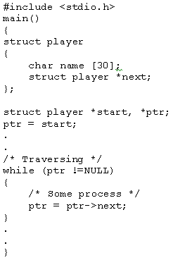
Traversing A Linked List (3)
The program code for the above would be as follows :

Slide 9
Searching A Linked List
The algorithm for searching a linked list would be -
Set ptr to start
Input name to be searched
While !ptr = NULL do steps 4 and 5
Compare name of the node to which ptr is currently pointing with the given name. If both are same, exit loop and go to step 6.
Set ptr to the next part of the node to which ptr is currently pointing.
If ptr ! = null, report given name exists in linked list, and if ptr = NULL, report name not found.

Slide 10
Inserting Nodes Into A Linked List
Allocate a memory block for a new code
Accept the information in this node
Set the next part of the new node to start
Set start to ptr
ITEM

Slide 11
Deleting A Node From A Linked List (1)
Accept the information (name of player) to be deleted.
Set ptr to start.
Do steps 4 and 5 while ptr!= NULL and the information of the node to which ptr is pointing is not equal to the given information.
Set prevptr (previous node) to ptr.
Set ptr to next of the node to which ptr is pointing currently.
Set next part of prevptr to next of ptr.
Free ptr and prevptr.

Slide 12
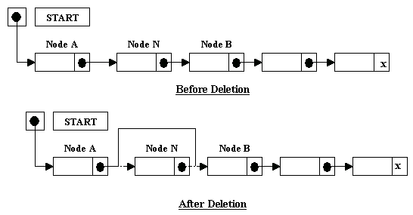
Deleting A Node From A Linked List (2)
Diagrammatically

Slide 13
Circular Linked Lists
Circular lists are often used instead of ordinary lists as many
operations are easier to state and implement using them.
The null pointer is not used and hence all pointers contain valid
addresses.
The first node may not require a special case as every node
has a predecessor.

Slide 14
Doubly Linked Lists
In a doubly linked list, the nodes are linked in both directions. Each
node of a doubly linked list contains three parts.
Pointer Field Prior
Pointer Field Next
Information Info

